Slide 1
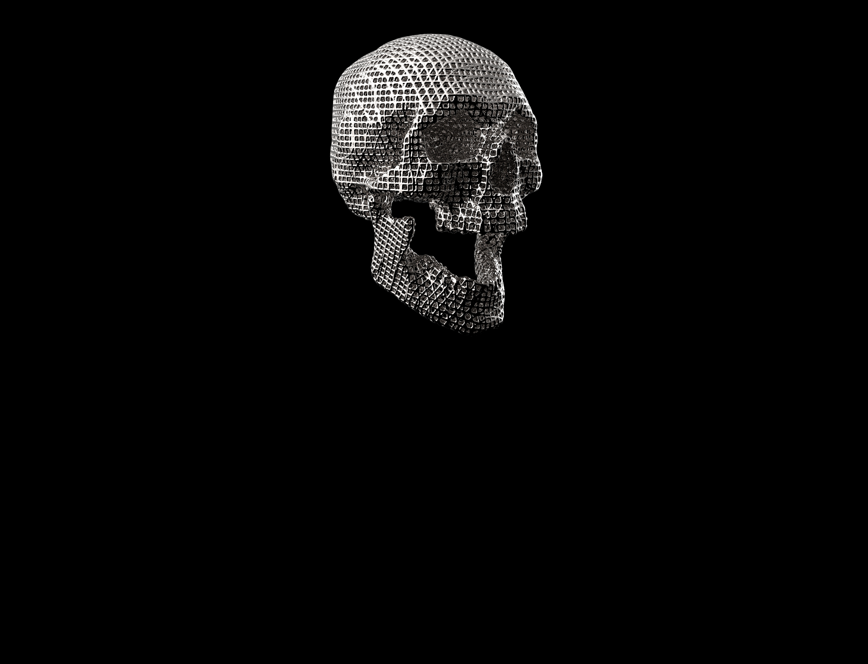
ISO Surfacing/Meshing
Quinten Cabo

Slide 2

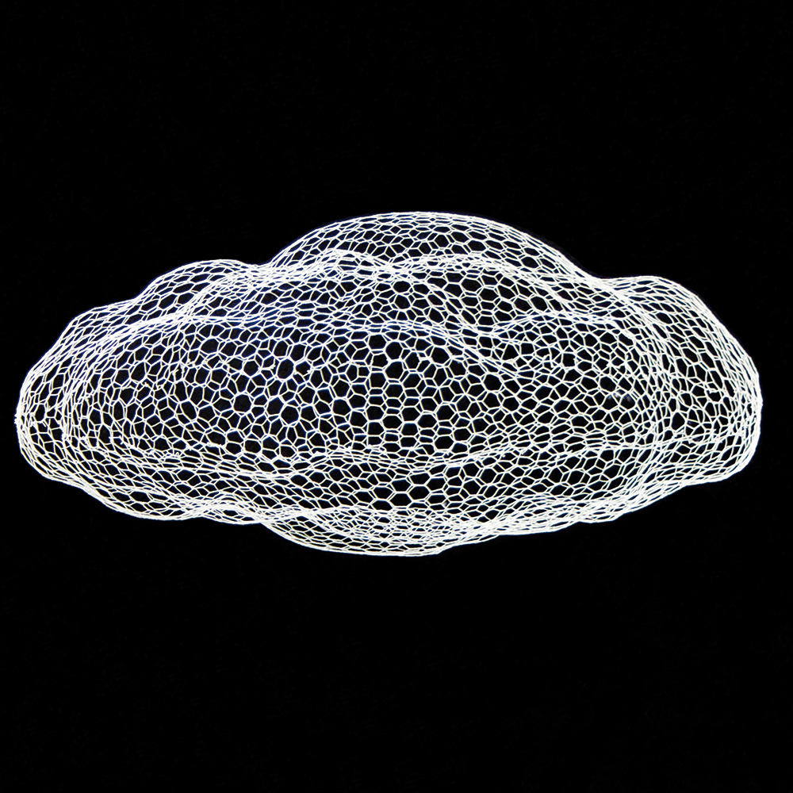
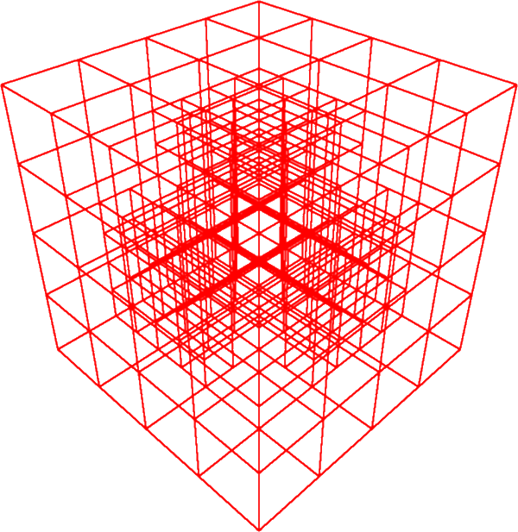
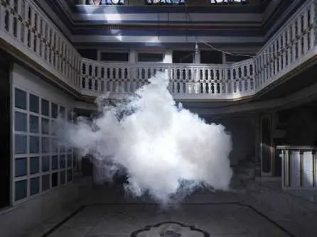
What is Iso Meshing?
Look at a volume
Divide the volume into voxels
Inspect each voxel
Try to find the boundary of a surface
Create a mesh of the boundary with a lot of triangles

Slide 3
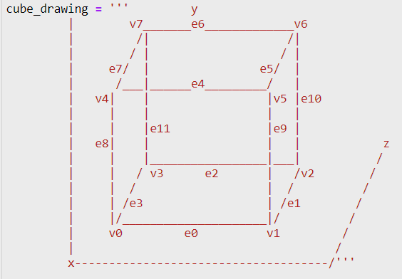
Algorithms Evaluated
Marching Cubes ✅
Marching Tetrahedra ✅
Surface Nets ✅
Dual Contouring ❌

Slide 4
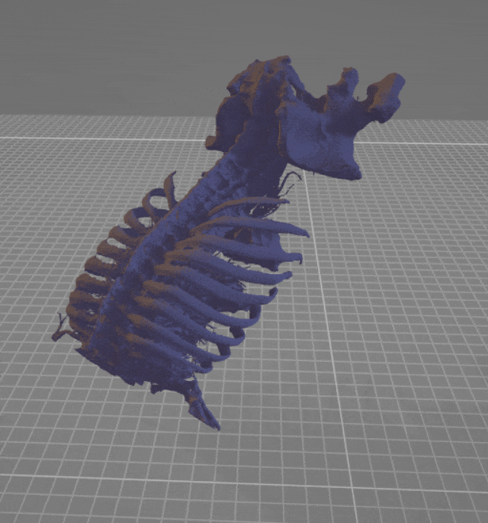
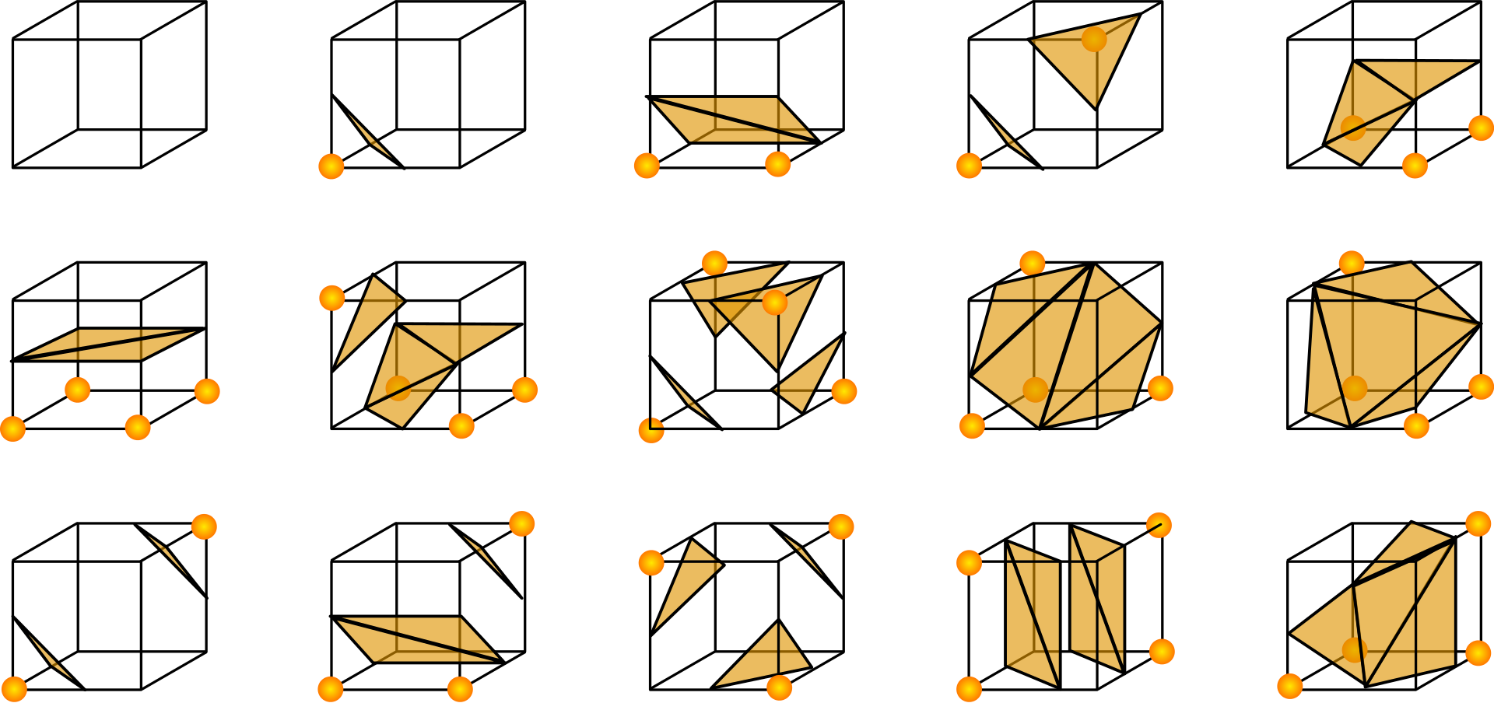
Marching Cubes (MC)
Look at the corners of each cube to find the triangles
Attempted own implementation but took too much time

Slide 5
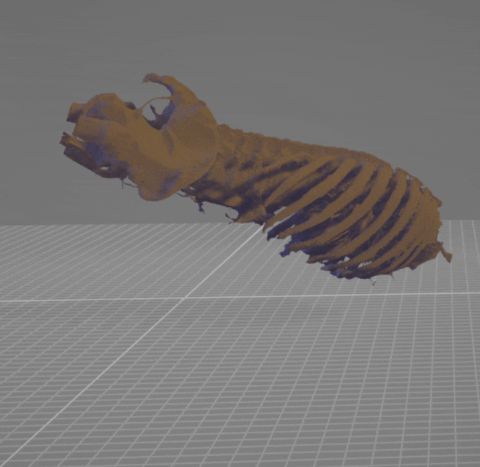
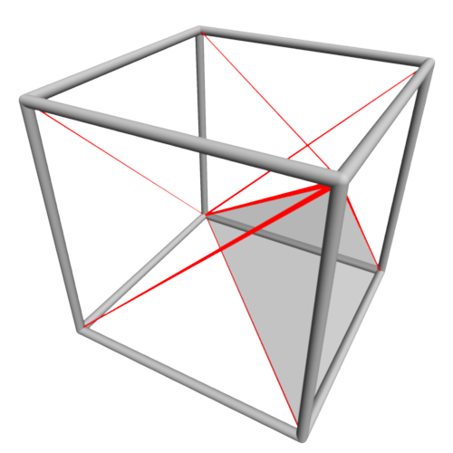
Marching Tetrahedra (MT)
Divide the cubes into multiple tetrahedra (pyramids but with only 3 sides) to find the boundary
More triangles are delineated, but it’s a more expensive algorithm

Slide 6
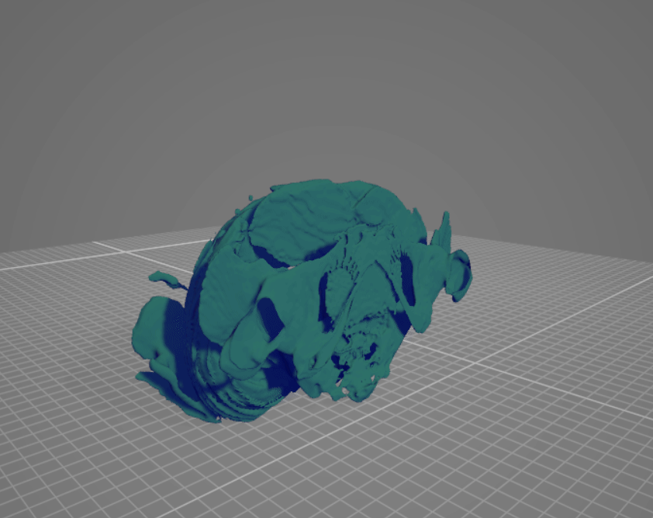
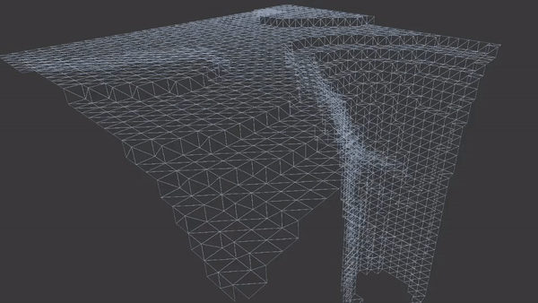
Surface Nets
Produces smoother meshes by smoothing the corners of the mesh multiple iterations

Slide 7
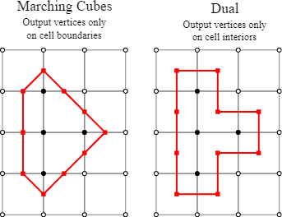
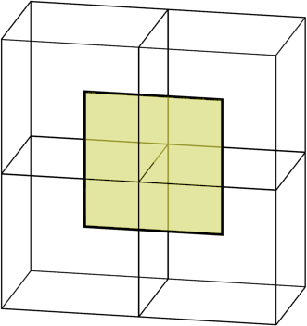
Dual Contouring (DC) – TBD
Takes an explicit function of the boundary by connecting cubes together
f(x,y,z) = 0, where 0 is on the boundary
Positive numbers are inside the boundary, negative numbers outside
A sign change indicates crossing
the boundary of the surface
Needs a function for the boundary
Not implemented

Slide 8
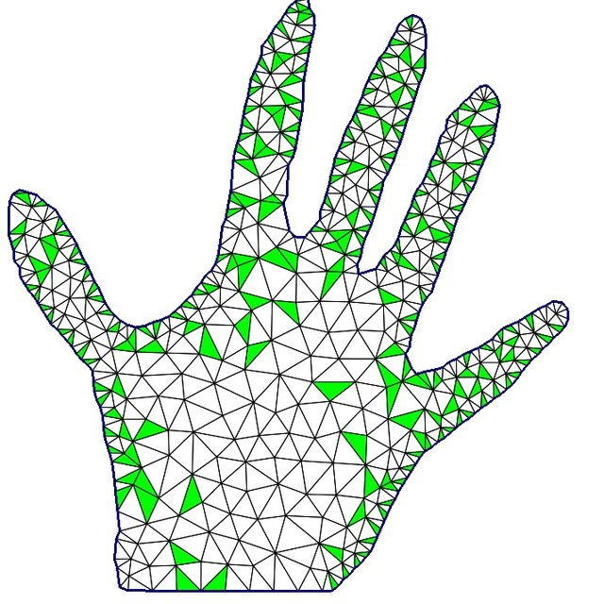
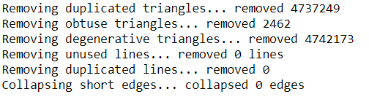
Clean up meshes
cleaned_mesh = cleanup_mesh(mesh, verbose=True)

Slide 9
Python Packages Used
Name | Purpose
pymesh | Loading, writing and optimizing mesh files
numpy | Fast matrix, vector computation
nibabel | Read / write access to some common neuroimaging file formats
skimage | Provides a marching cubes implementation
mcubes | Provides another marching cubes implementation and smoothing
cleaned_mesh = cleanup_mesh(mesh, verbose=True)

Slide 10
Results Algorithms
Results come from a volume of size 512x512x128
CPU: I7-10870H, GPU RTX 3080 laptop = fast laptop
Algorithm | Marching Cubes | Marching Tetrahedra | Surface Nets | Dual contour
Speed | Fast +- 10 sec/mesh | Really Slow +- 2 sec/layer 20 min/mesh | Slow +- 5m 4s | -
Mesh Quality | 5M triangles 16M vertices | 16M triangles 48M vertices | - | -
Mesh Ascetics (subjective) | A little worse then MT | Looks a little better then MC | - | -
Ease of use | Easy, 2 functions | Harder, Can only be saved as .stl file | - | -
File size | 200.000 kb | 500.000 kb | - | -

Slide 11
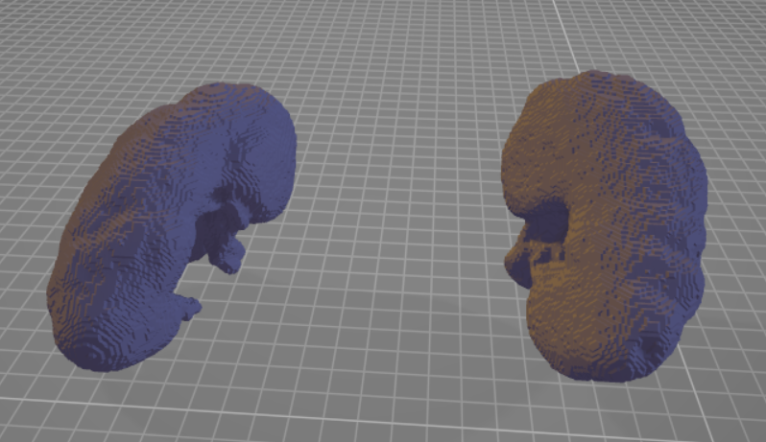
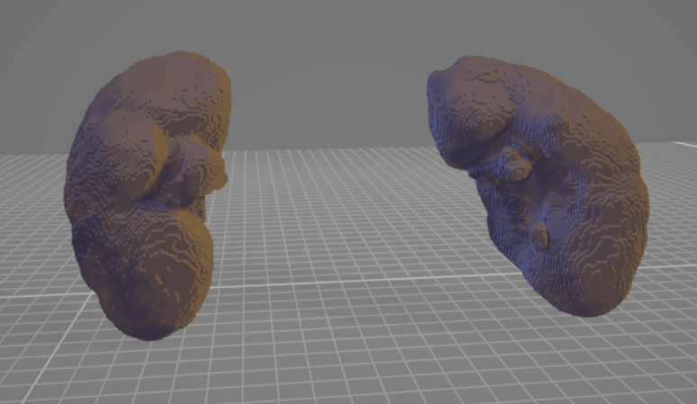
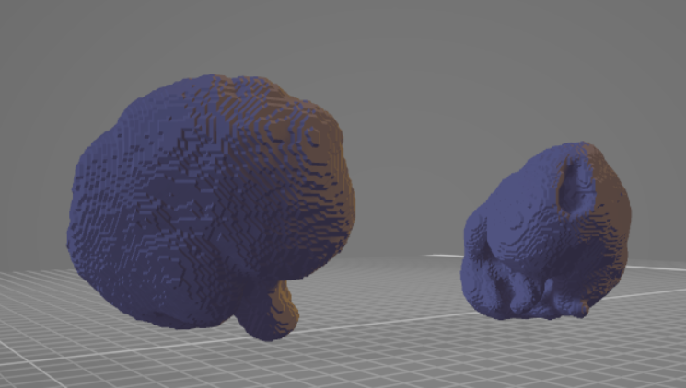
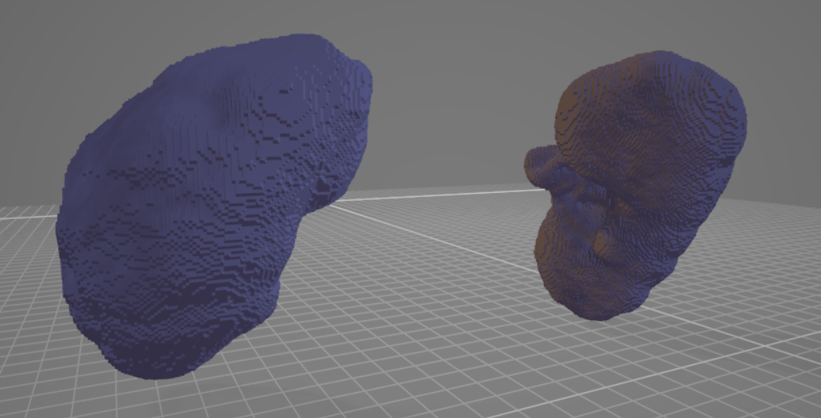
Meshes Kidneys
Marching Cubes Marching Tetrahedra

Slide 12
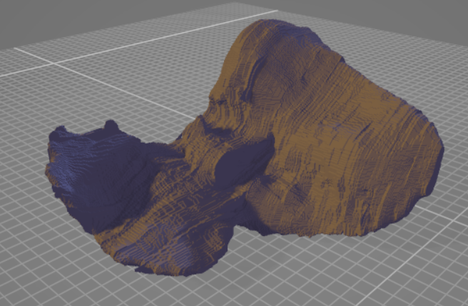
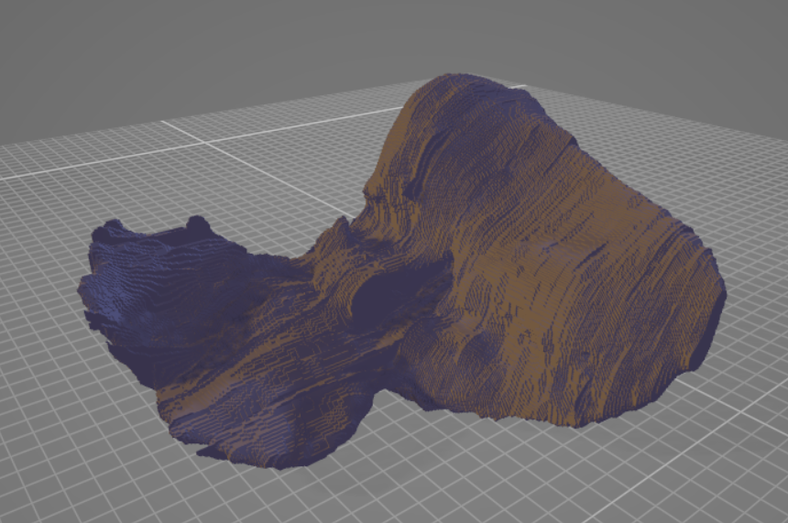
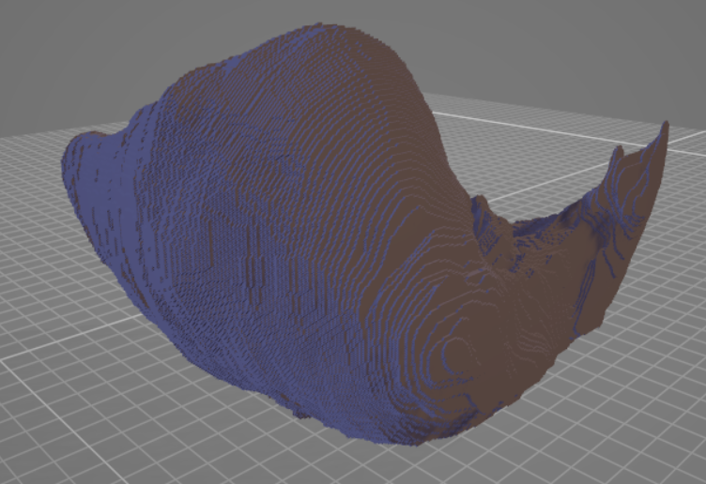
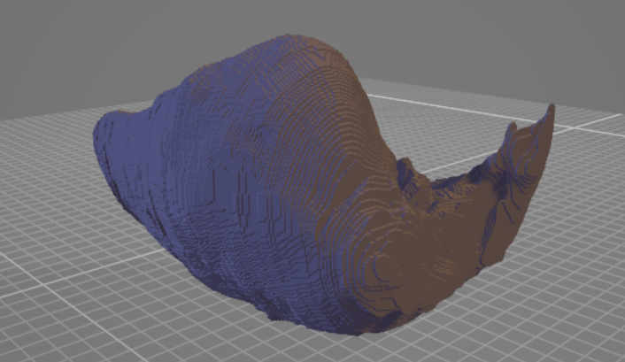
Meshes Liver
Marching Cubes Marching Tetrahedra

Slide 13
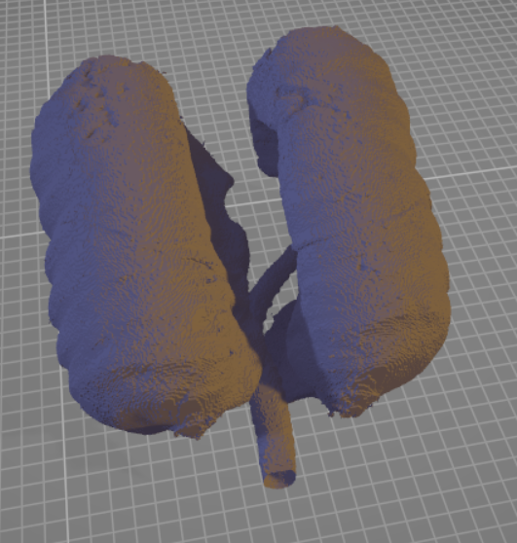
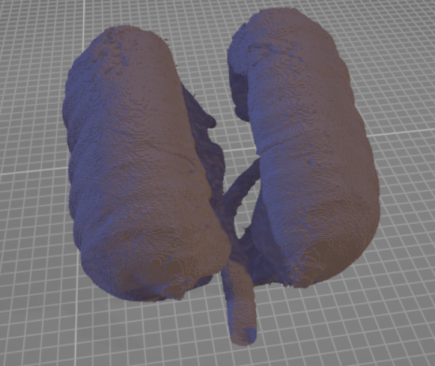
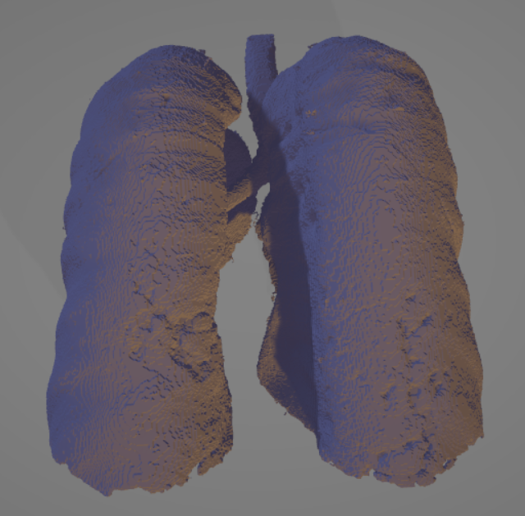
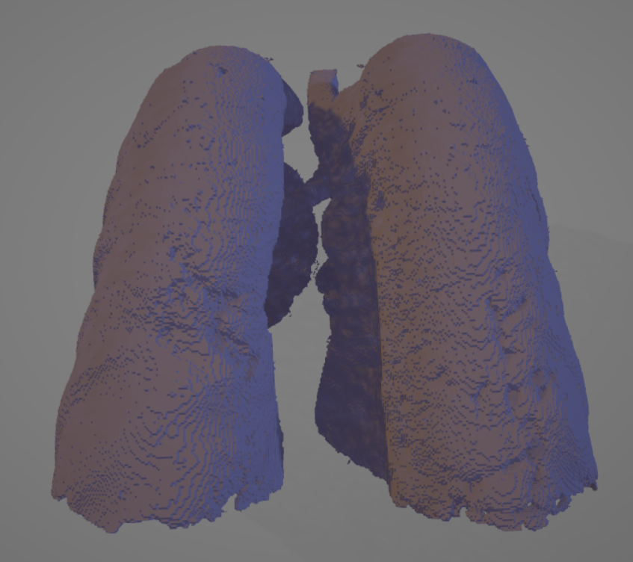
Meshes Lungs
Marching Cubes Marching Tetrahedra

Slide 14
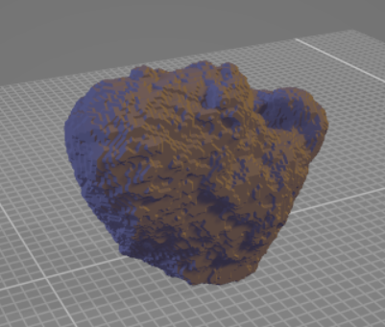
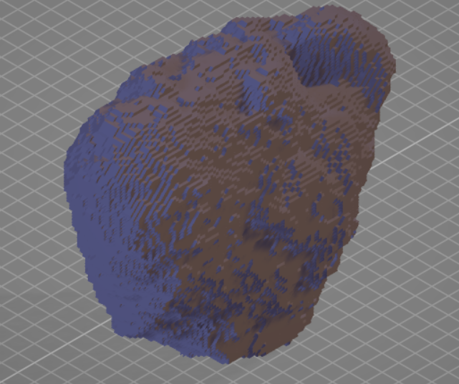
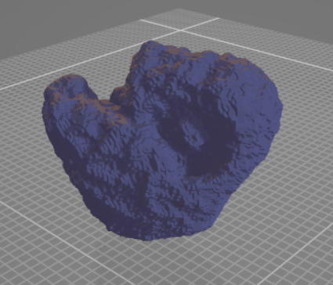
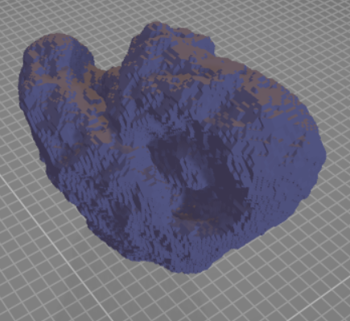
Meshes Bladder
Marching Cubes Marching Tetrahedra

Slide 15
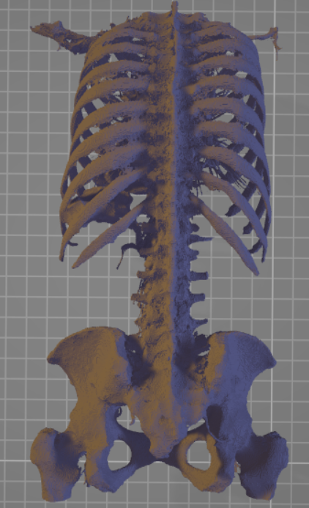
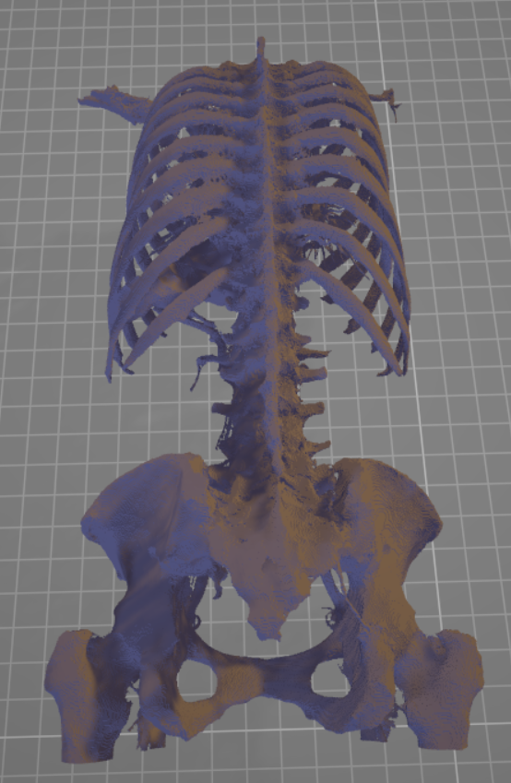
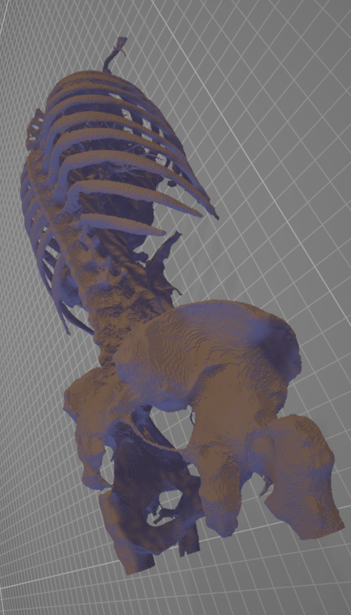
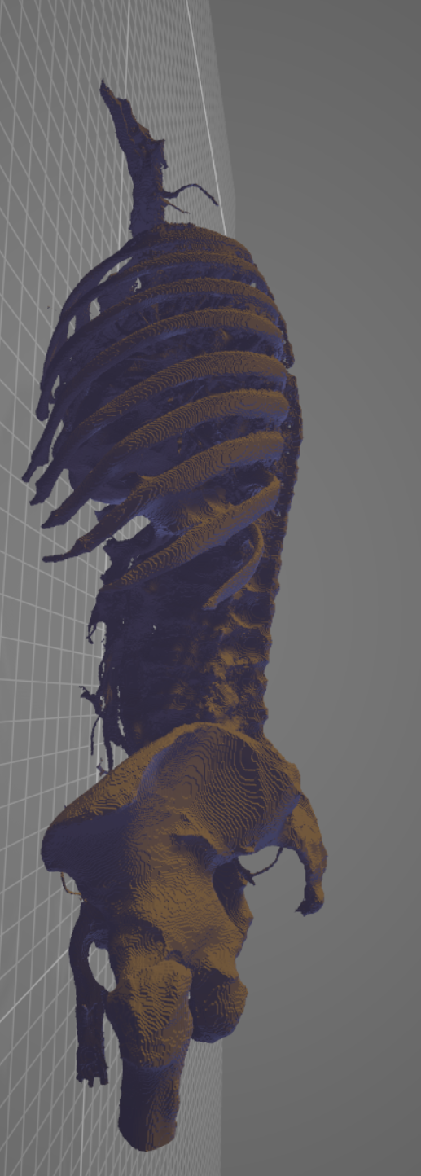
Meshes Bones
Marching Cubes Marching Tetrahedra

Slide 16
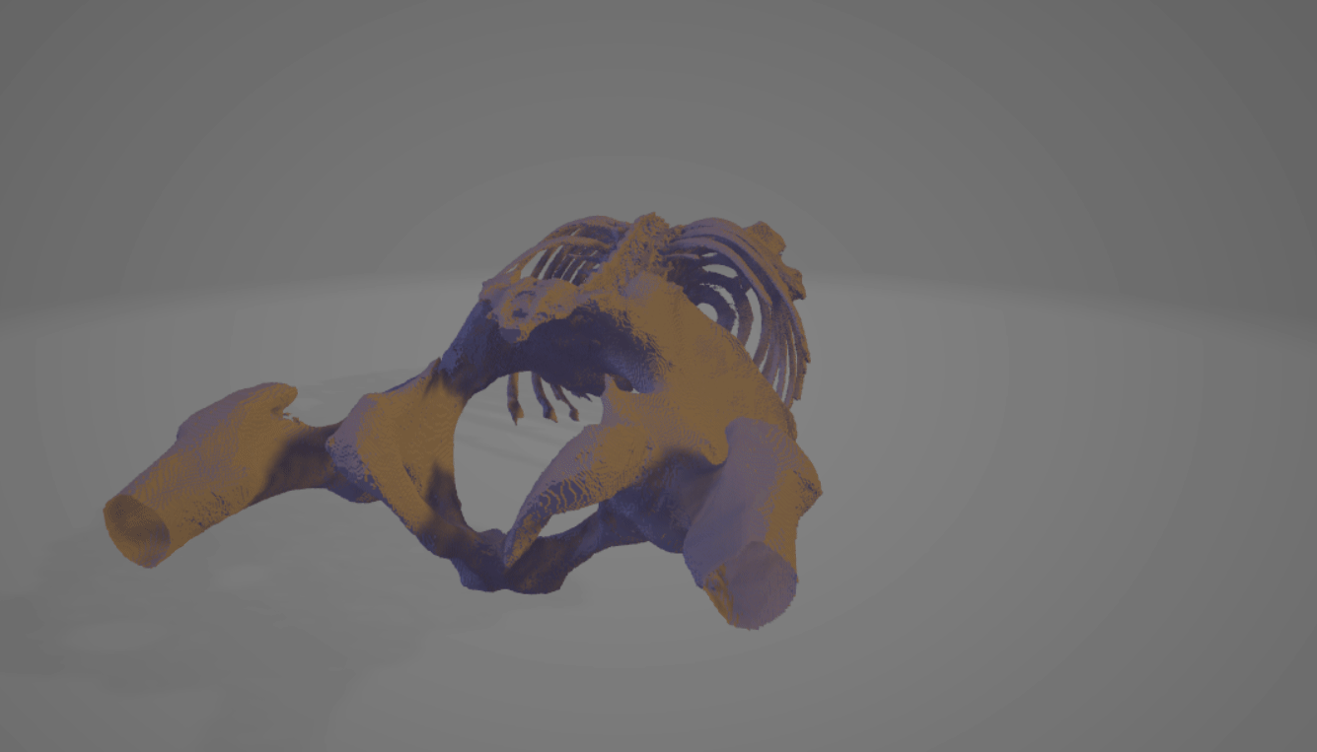
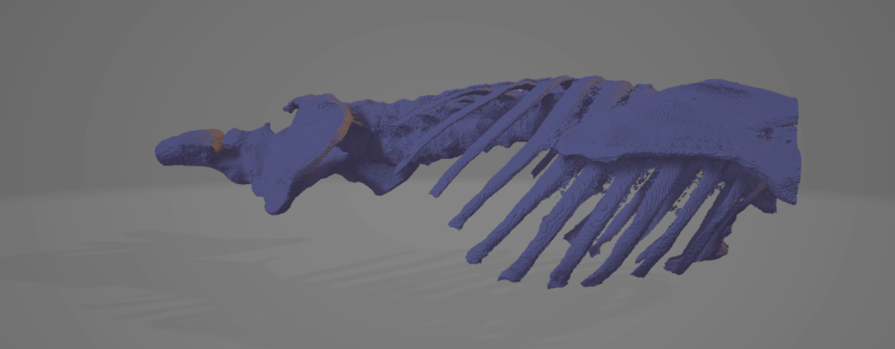
Bones Meshes
Marching Cubes Marching Tetrahedra

Slide 17
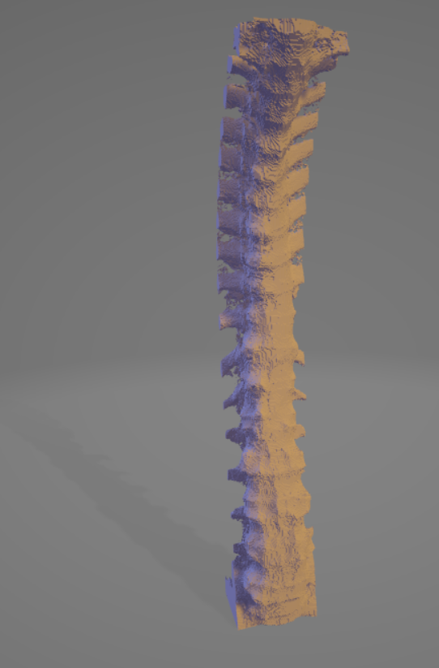
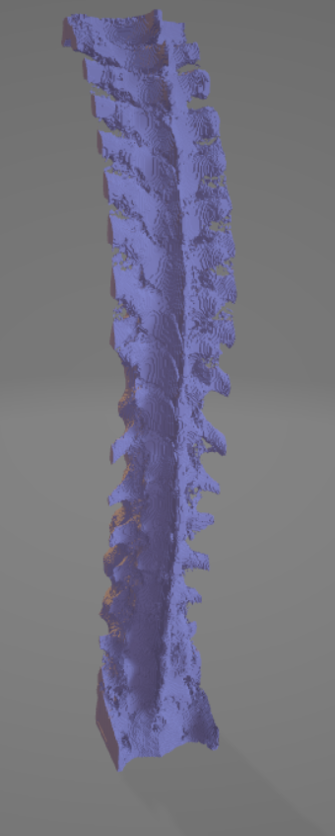
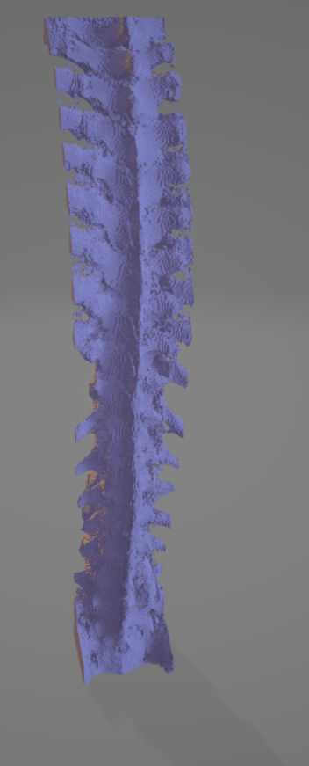
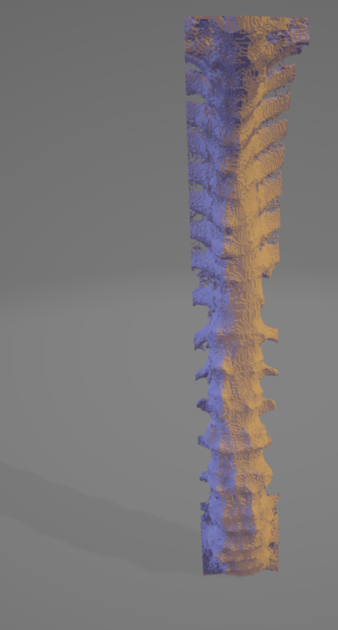
Vertebrate Mesh
Marching Cubes Marching Tetrahedra

Slide 18
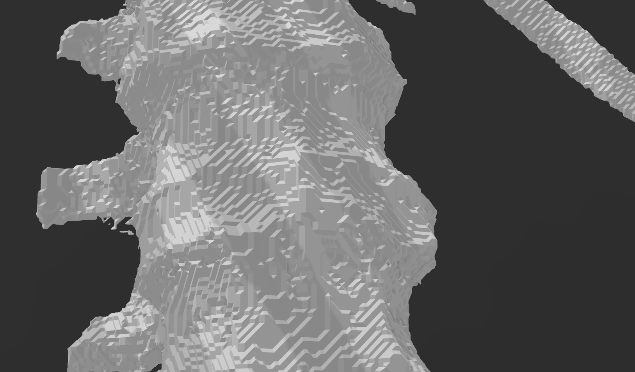
Close-up

Slide 19
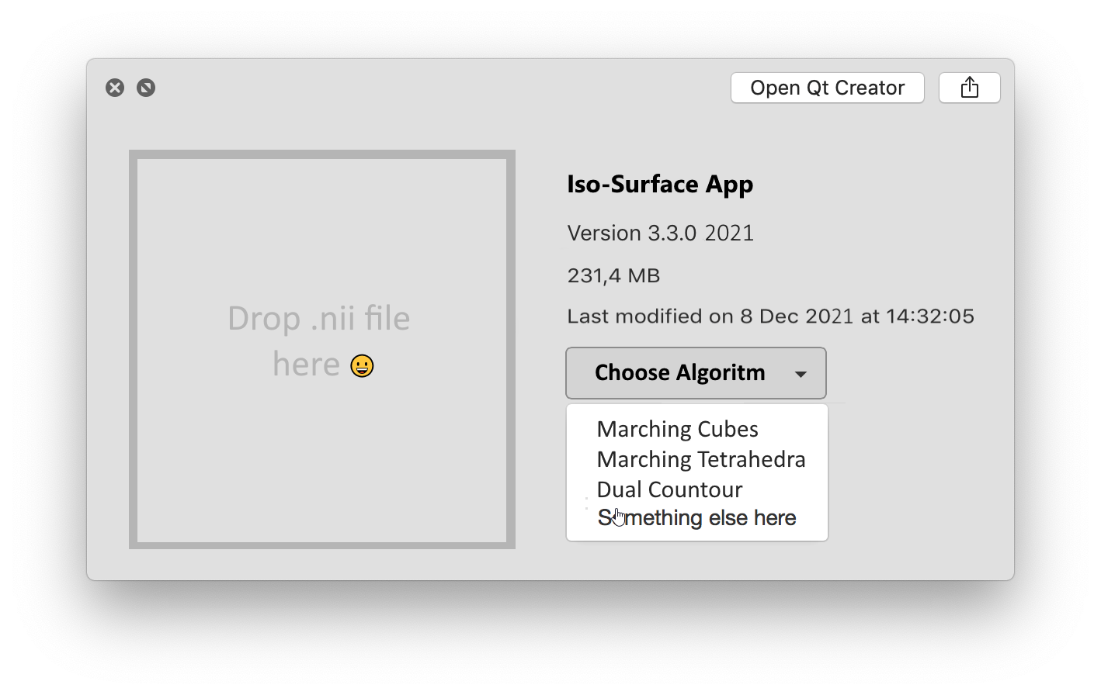
Further Directions
Working smoothing of meshes
Easy user interface
Implementing more algorithms
https://github.com/tintin10q/python-isosurface-notebooks

